Slide 1
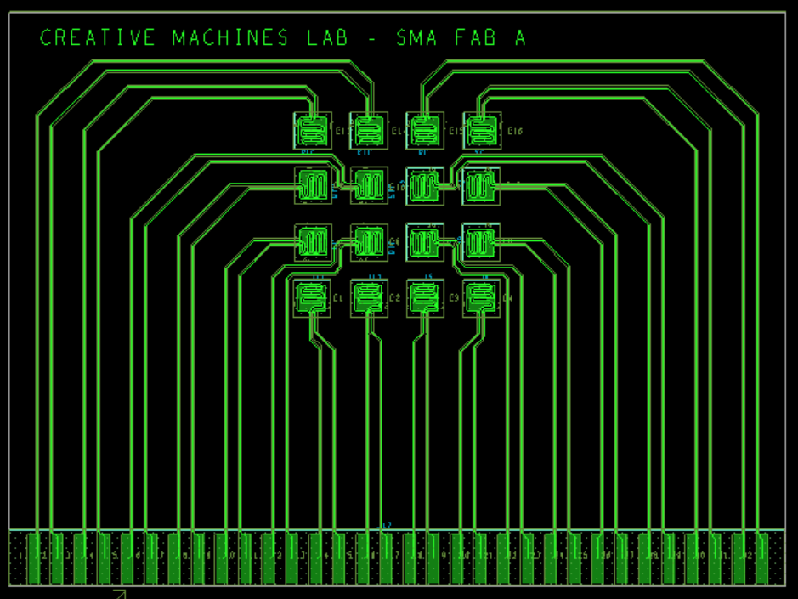

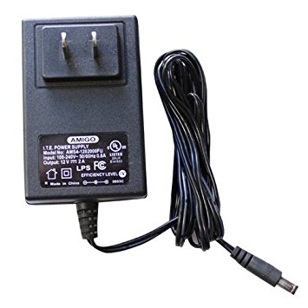
Capabilities
Design electronics to digitally control a 4x4 array of electrodes
16 independent channels
Communicate through USB port
12VDC power adapter
Low static power dissipation

Slide 2
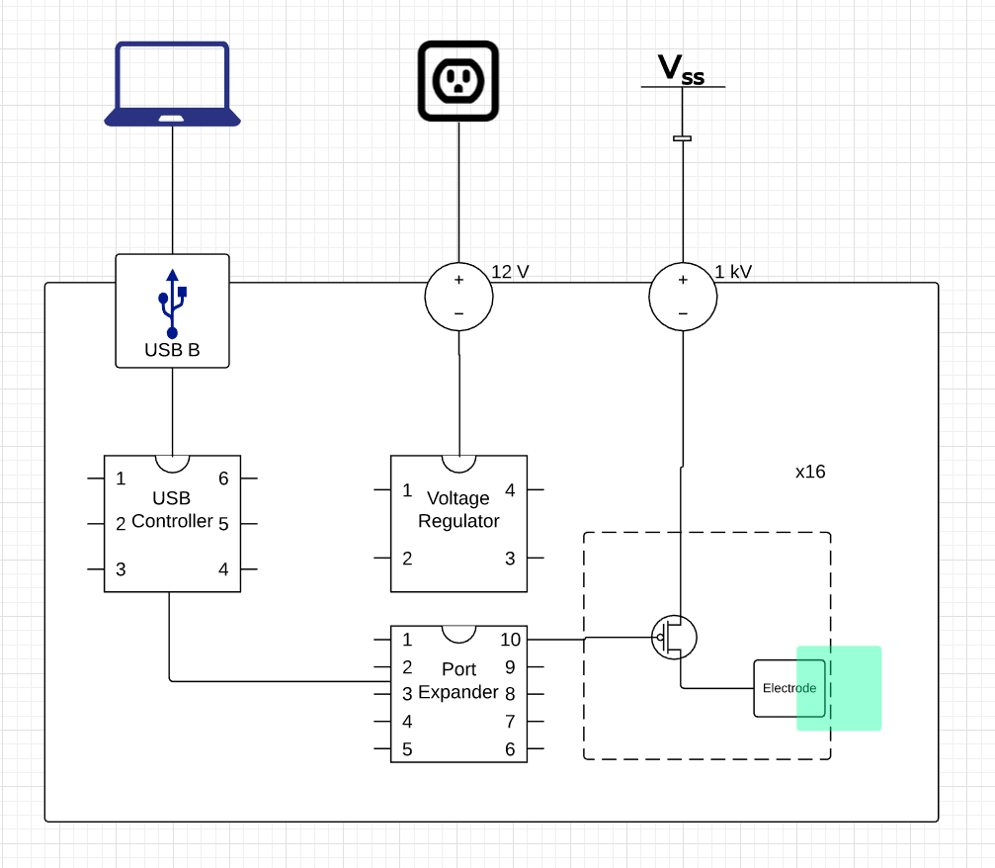
Block Diagram
INPUT
USB B connector
5.5-2.1mm DC jack
IC
USB Controller
Port Expander
VR
Power Transistors
OUTPUT
x16 Electrodes

Slide 3
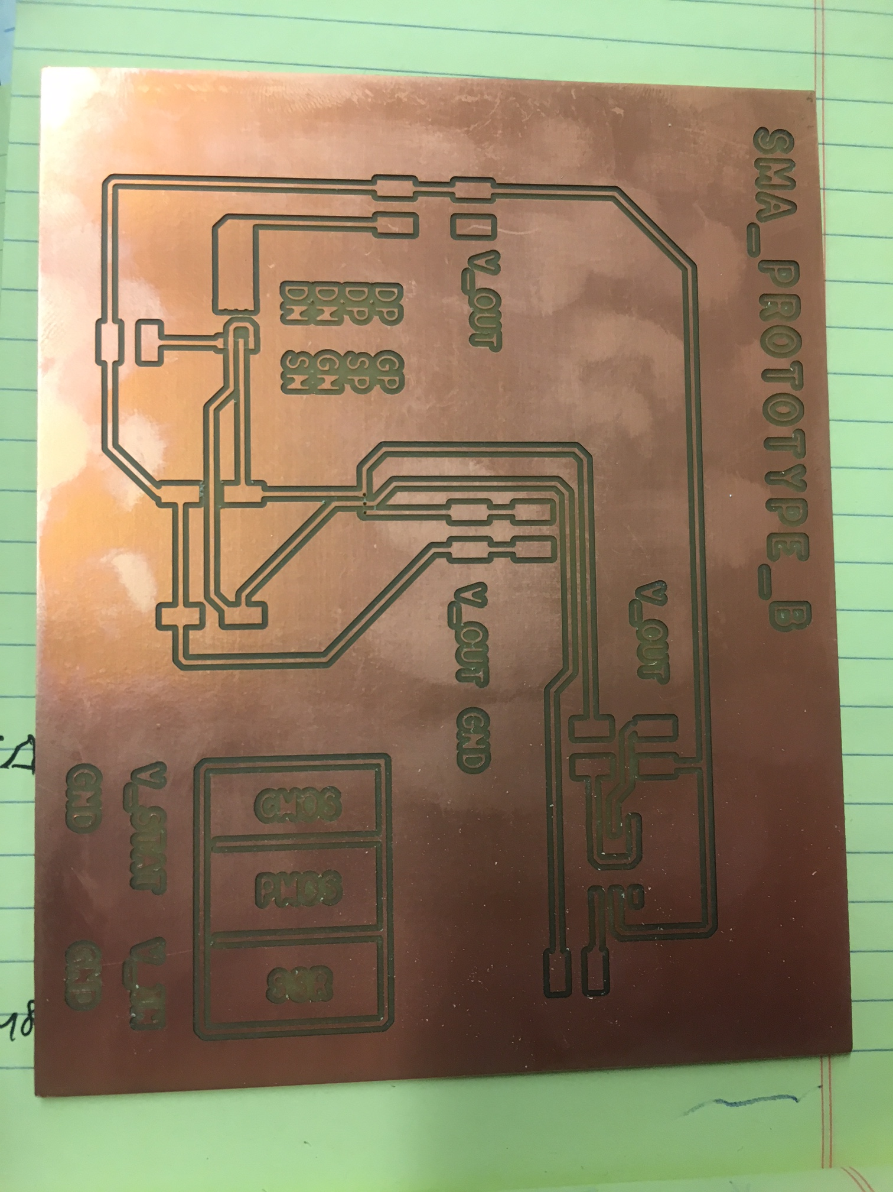
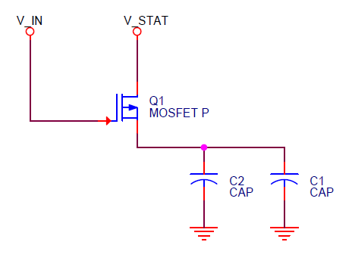
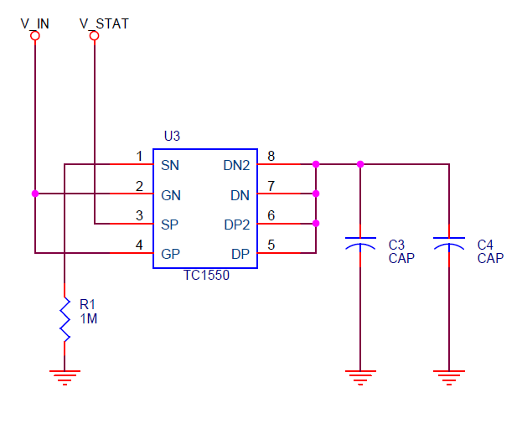
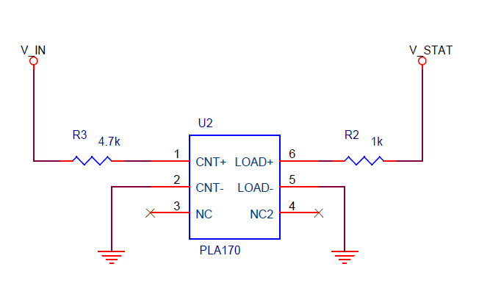
Prototypes
Test out various dynamic charging schemes
Single PMOS
CMOS Inverter
SSR
{Ongoing}

Slide 4
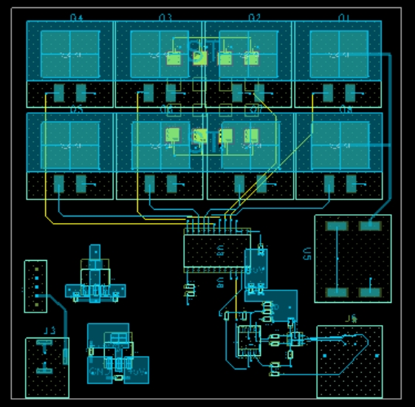
Design
Laid out essential components
Completing prototyping activities before sending out to fab shops

